Slide 1
Electrical Conduction and Breakdown Mechanisms in Gases

Slide 2


Slide 3
Typical composition of atmospheric air
Type of matter | Components | Notes
 | Nitrogen – 78% Oxygen – 21% Other gases – 1%
Water vapour | Tiny water particles
Dust particles | Tiny solid particles of various types floating in air
Charged particles | Electrons (1.602 x 10⁻¹⁹C, 9.110 x 10⁻²⁸g and 130 000 smaller than proton) Positive ions Negative ions | Constantly produced & recombine but under equilibrium = about 10³ e⁻/ion pairs/cm³ Can be micro sized charged particles e.g. electrons attaching to dust particles
Gas molecules
Vary with location and environmental conditions

Slide 4
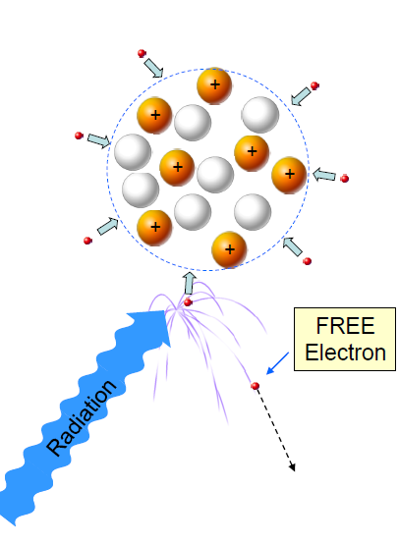
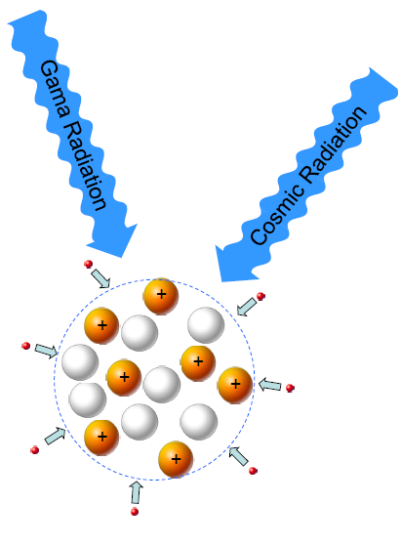
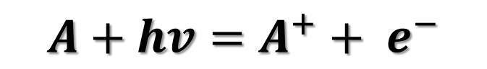
Natural photo ionisation
$$A+hv=A^{+}+ e^{−}$$

Slide 5
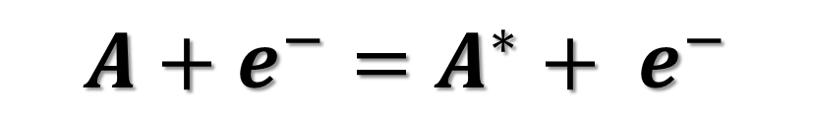
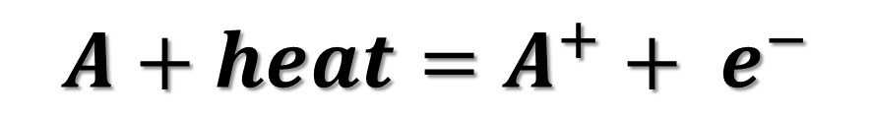
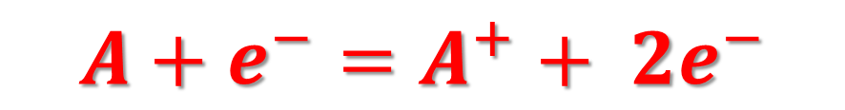



Ionisation processes
$$A+e^{−}=A^{∗}+ e^{−}$$
Excitation
$$A^{∗}=A+hv$$
De-excitation
$$A+e^{−}=A^{−}$$
Attachment
$$A^{−}=A+e^{−}$$
Detachment
$$A+heat=A^{+}+ e^{−}$$
Thermal ionisation
$$A+e^{−}=A^{+}+ {2e}^{−}$$
Ionisation by collision
The process responsible for electronic avalanches

Slide 6
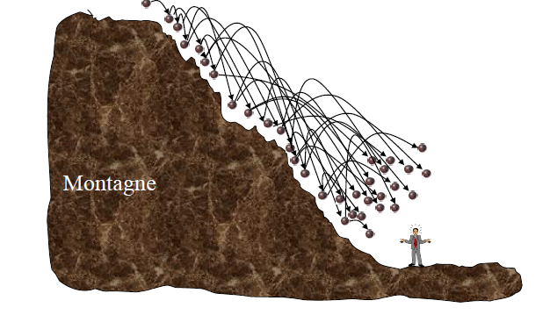
Rock avalanches

Slide 7
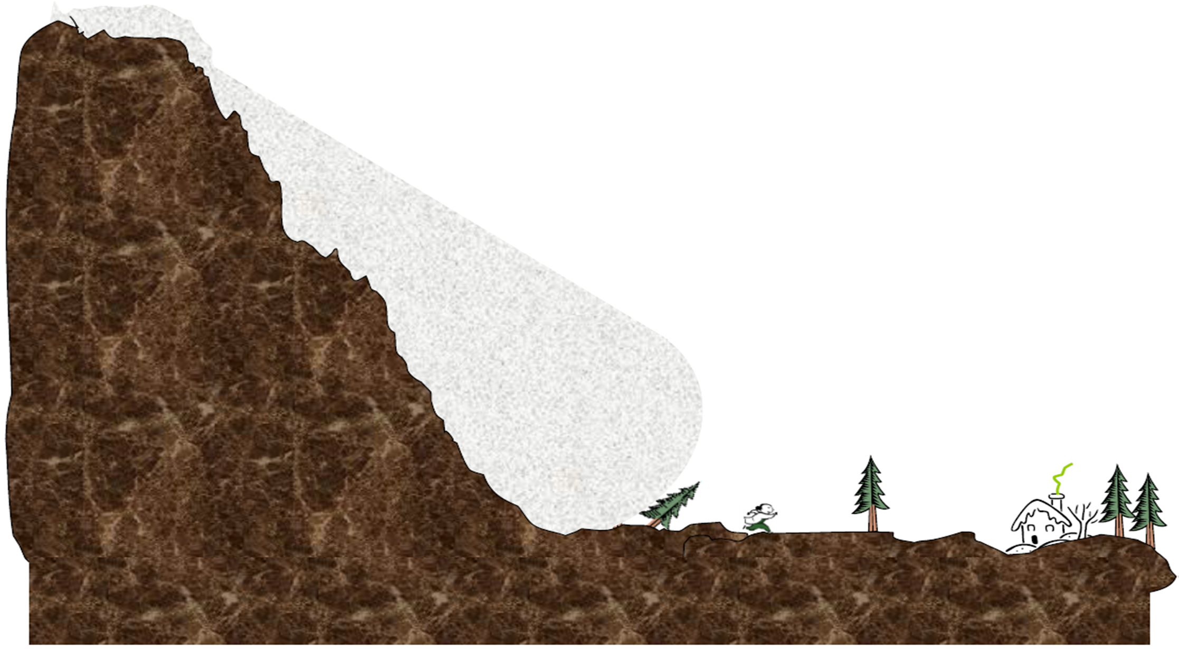
Snow avalanches

Slide 8
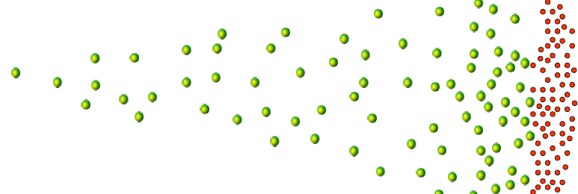


Non-self-sustained avalanches
Anode(+)
Cathode(-)
(I)
$$N=N_{0}e^{αx}$$
Electronic current
Number of electrons (N)
Ionic current
Gap distance (x)
t1
t2
(t)

Slide 9
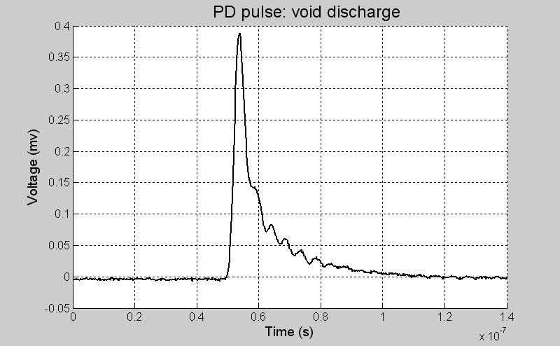
electronic portion
ionic portion

Slide 10
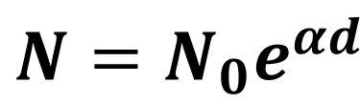
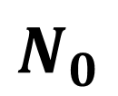
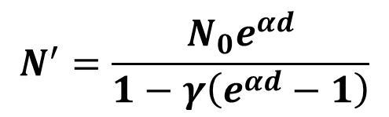
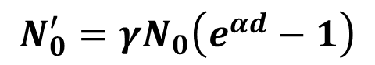
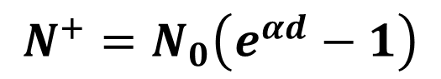

Avalanches with feedback mechanisms
Cathode(-)
Anode(+)
$$hv$$
$${N=N}_{0}e^{αd}$$
$$N_{0}$$
Primary avalanche
$${N^{+}=N}_{0}\left(e^{αd}−1\right)$$
$${N_{0}^{′}=γN}_{0}\left(e^{αd}−1\right)$$
Secondary avalanche
$$N^{′}=\frac{N_{0}e^{αd}}{1−γ\left(e^{αd}−1\right)}$$
d

Slide 11

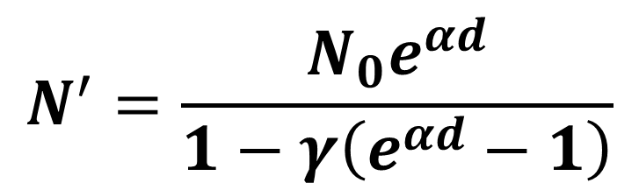
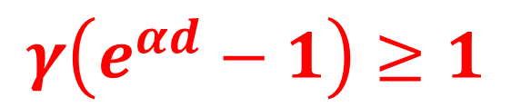
Townsend breakdown criterion
$$N^{′}=\frac{N_{0}e^{αd}}{1−γ\left(e^{αd}−1\right)}$$
$$γ\left(e^{αd}−1\right)≥1$$
With secondary feedback mechanisms, if
Then the discharge is self-sustained resulting in breakdown

Slide 12
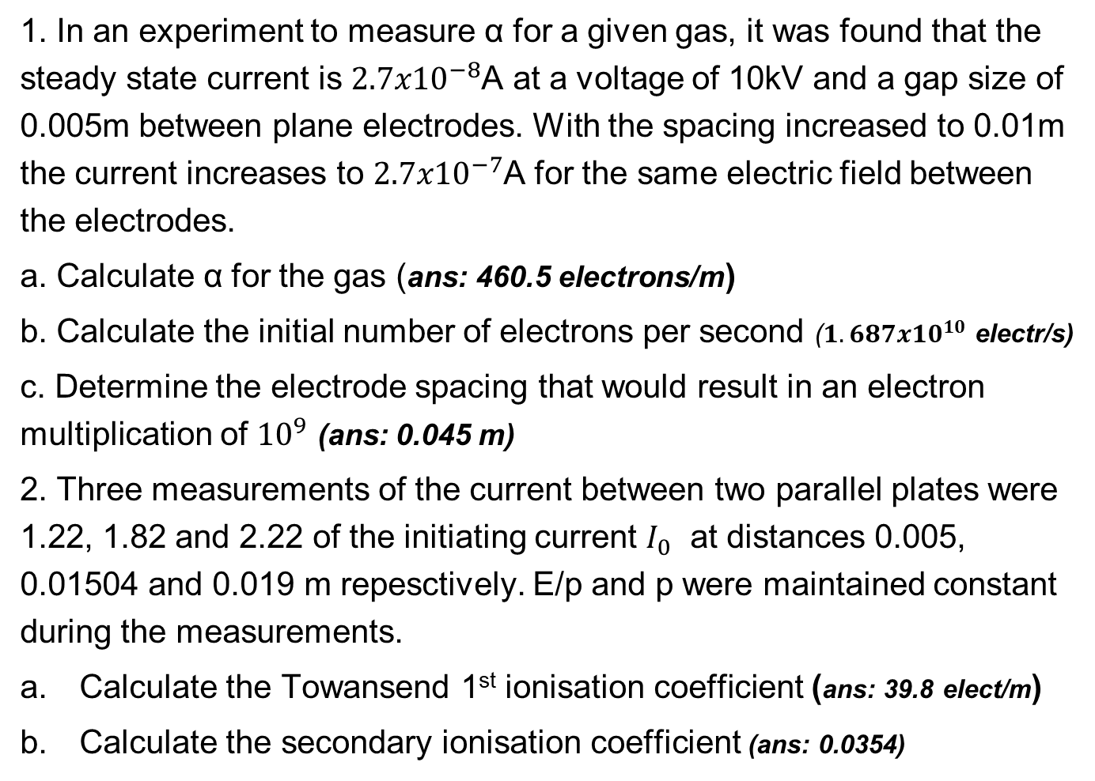
Exercise problem
1. In an experiment to measure α for a given gas, it was found that the steady state current is ${2.7x10}^{−8}$A at a voltage of 10kV and a gap size of 0.005m between plane electrodes. With the spacing increased to 0.01m the current increases to ${2.7x10}^{−7}$A for the same electric field between the electrodes.
a. Calculate α for the gas (ans: 460.5 electrons/m)
b. Calculate the initial number of electrons per second (${1.687x10}^{10}$ electr/s)
c. Determine the electrode spacing that would result in an electron multiplication of ${10}^{9}$ (ans: 0.045 m)
2. Three measurements of the current between two parallel plates were 1.22, 1.82 and 2.22 of the initiating current $I_{0}$ at distances 0.005, 0.01504 and 0.019 m repesctively. E/p and p were maintained constant during the measurements.
Calculate the Towansend 1st ionisation coefficient (ans: 39.8 elect/m)
Calculate the secondary ionisation coefficient (ans: 0.0354)

Slide 13
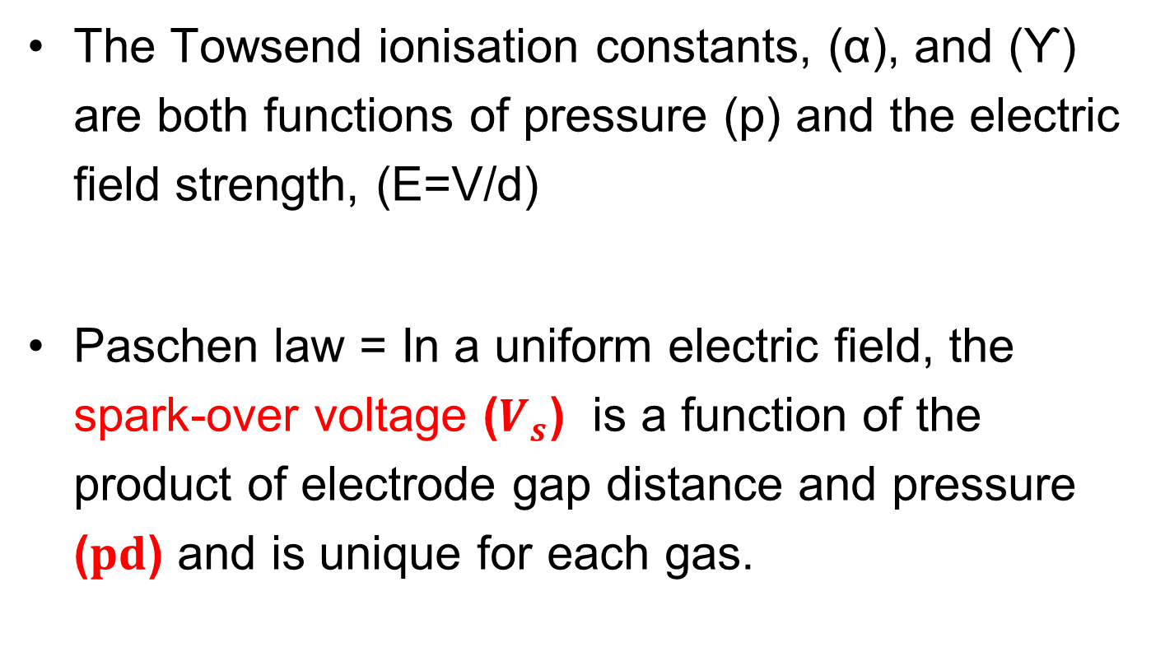
The Paschen law
The Towsend ionisation constants, (α), and (ϒ) are both functions of pressure (p) and the electric field strength, (E=V/d)
Paschen law = In a uniform electric field, the spark-over voltage ($V_{s}$) is a function of the product of electrode gap distance and pressure ($pd$) and is unique for each gas.

Slide 14
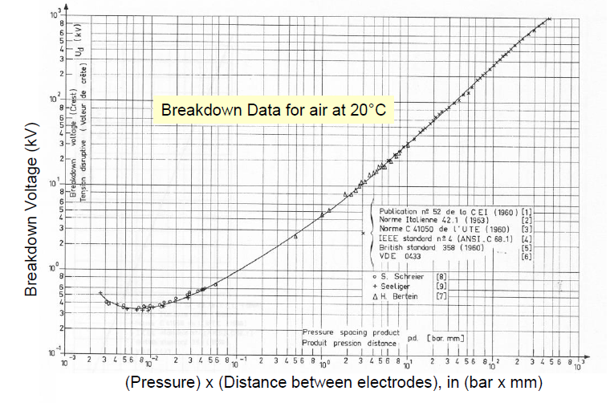
Paschen curve for air

Slide 15
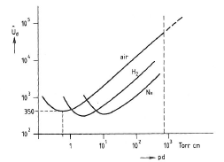
Paschen curves for different gases

Slide 16
Exercise problem
Figure below shows the cross section of a single turn motor coil in a stator slot. The epoxy insulation around the conductor is 3 mm thick. A manufacturing process error causes a 1 mm thick air bubble to be trapped midway in the insulated slot.
Assuming a pressure of 1.0 bar in the air bubble, determine the minimum RMS value of the voltage which when applied between the conductor and slot will cause partial discharge activity to commence in the bubble. The relative permittivity of the epoxy (insulating material) may be assumed to be 4. (Ans: 4.8 kVrms)
Sketch the electric field profile strength variation across the slot from the conductor through the insulation and air bubble to the opposite electrode.

Slide 17
Townsend vs Streamer mechanisms
Townsend
Low p.d. (small gaps of uniform field)
Characterised by ϒ feedback mechanisms thus a function of the cathode material
Diffuse light filling the available space
Low temperature
Time to breakdown order of µs (relatively long)
Streamer
High p.d. (bigger gaps and in non-uniform fields)
Characterised by feedback of photons hitting the nearest atoms (secondary avalanches) therefore no cathode effect
Filamentary, tortuous bright channels branching at greater distances
High temperature 5000 to 20000
(temp of the sun)
Time to breakdown order of 1 to 100 ns

